Slide 1


WEB DEVELOPMEN PORTFOLIO
STUDENT NAME: Pavithra s
REGISTERNOANDNMID:222407790/0FBC0B459F68BB2B5BC437A0FE952FB3
DEPAREMENT: B SC Computer Science
COLLEGE: COLLEGE /UNIVERSITY: Tagore college of arts and science/Madras University

Slide 2
AGENDA
1. Problem Statement
2. Project Overview
3. End Users
4. Tools and Technologies
5. Portfolio design and Layout
6. Features and Functionality
7. Results and Screenshots
8. Conclusion
9. Github Link

Slide 3
PROBLEM STATEMENT
Problem Statement
Students and beginners struggle to present their technical skills effectvely.Traditional resumes fail to show interactive projects or coding ability.In today’s digital world, students, professionals, and developers need an online presence to showcase their skills, projects, and achievements.ARecruiters, clients, and collaborators expect a digital portfolio that demonstrates not only technical knowledge but also design and problem-solving ability.A responsive digital portfolio built with HTML, CSS, and JavaScript.

Slide 4
PROBLEM OVERVIEW
In today’s digital world, individuals and businesses need an online presence to showcase their skills, projects, and services. However, many lack a well-structured, interactive, and professional platform to represent their work effectively. Without a portfolio, it becomes difficult to:
Present skills, projects, and achievements in an organized manner
Build trust with employers, clients, or collaborator
interactive, and responsive websites using technologies like HTML (structure), CSS (design), and JavaScript (interactivity). This ensures a strong online presence, easy communication, and professional presentation.

Slide 5
WHO ARE THE END USERS ?
End Users are the people who directly use, view, or interact with a web development portfolio to evaluate the developer’s skills, projects, and capabilities.
Recruiters & Hiring Managers
Clients
People or companies who want to hire you for freelance or contract work
Peers & Collaborators
Other developers, designers, or team members who may want to collaborate
Educators / Mentors
Teachers or guides who may assess your learning progress.

Slide 6
TOOLS AND TECHNIQUES
1. Tools Used
HTML (HyperText Markup Language):
Used to create the structure of the portfolio (headings, navigation bar, sections like About, Projects, Skills, Contact).
CSS (Cascading Style Sheets):
Used for styling—colors, fonts, layout, responsiveness, and animations.
JavaScript:
Used to add interactivity (sliders, smooth scrolling, pop-ups, form validation).
Code Editor: VS Code, Sublime Text, or Notepad++.
Browser Developer Tools: Chrome DevTools or Firefox Inspector for debugging and testing.
Version Control: Git/GitHub for saving versions and publishing online.
2. Techniques Used
Navigation Techniques:
Sticky navigation bar, smooth scrolling with JavaScript, anchor links.
CSS Styling Techniques:
Flexbox & CSS Grid for layouts
Transitions & Animations for hover effects
Shadows, gradients, rounded corners for modern UI
JavaScript Techniques:
DOM manipulation for showing/hiding elements﻿
Form validation for “Contact Me” section
Smooth scroll and interactive project gallery

Slide 7
PORTFOLIO DESIGN AND LAYOUTS
Clean & Professional UI with consistent colors and fonts.
Header / Navigation Bar – Quick links to sections.
Hero Section – Name, tagline, short intro.
About Section – Personal info, background.
Skills Section – Technical expertise.
Projects Section – Showcase of works.
Contact Section – Contact form or links.
Footer – Copyright, social icons.
Responsive Design – Works on mobile, tablet, and desktop.
JavaScipt Interactivity – Smooth scrolling, alerts, or animations.

Slide 8
FEATURES AND FUNCTIONALITY
1.Responsive Design – Works on mobile, tablet, and desktop.
2. User-Friendly Navigation – Simple menus, smooth scrolling, and easy-to-find sections.
3. Professional Introduction – A short bio/about section with skills and expertise.
4. Project Showcase – Display past projects with screenshots, live links, and code (GitHub).
5. Interactive UI – Smooth animations, hover effects, transitions.
6. Blog/Articles (Optional) – To share knowledge, tutorials, or thoughts.
7. Downloadable Resume – Option to download your CV.
8. Contact Form / Social Links – Easy way for employers/clients to reach you.
9. Search Engine Optimization (SEO) – So recruiters can find your site.
10. Dark/Light Mode (Optional) – Addspersonalization for users.
Example Portfolio Flow:
Home Page: Introduction with animation
About Section: Your background & skills.
Projects Section: Interactive project cards.
Contact Section: Form + social media links.

Slide 9
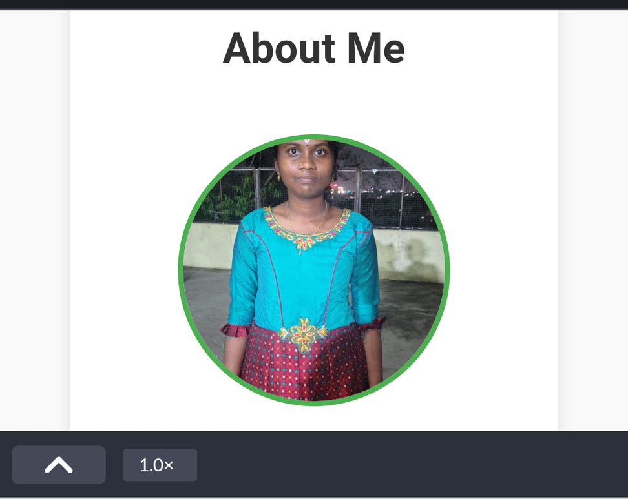
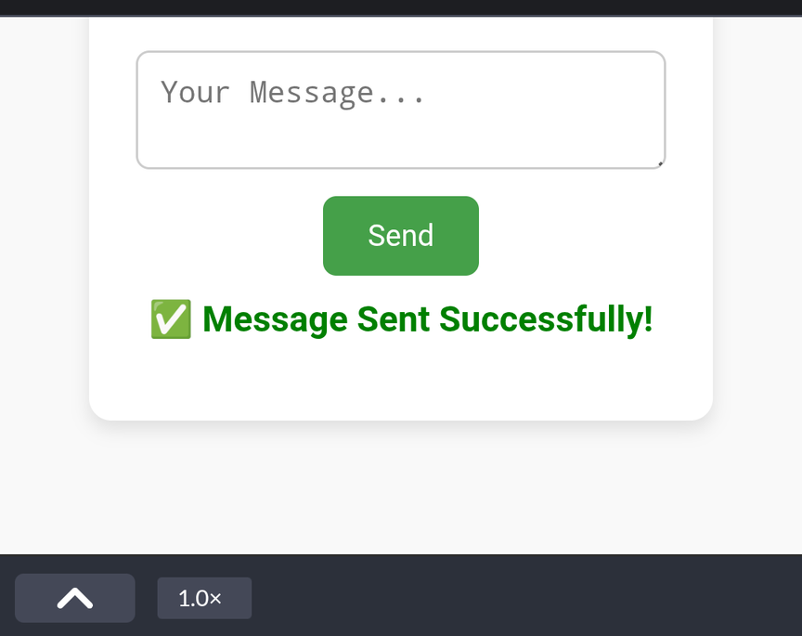
RESULTS AND SCREENSHOT
A homepage with your photo, name, and title.
Sections like Home, About, Skills, Services, Projects, and Contact.
A contact form where users can enter Name, Email, and Message → when submitted it shows "Message sent successfully" (using JavaScript).
Responsive design (works on mobile, tablet, laptop).
Attractive styling (usi
ng CSS).

Slide 10
CONCUSSION
In conclusion, this portfolio highlights my journey and skills in web development, showcasing my ability to design and build responsive, user-friendly, and functional websites. Through the integration of HTML, CSS, and JavaScript, I have created interactive pages that reflect both technical knowledge and creativityThis portfolio not only demonstrates my coding proficiency but also my problem-solving, design thinking, and adaptability to modern tools and frameworks.

Slide 11
THANK YOU

